Slide 1
Advancing Sentiment Analysis in Serbian Literature:
A Zero and Few-Shot Learning Approach Using the Mistral Model
Milica Ikonić Nešić¹, Saša Petalinkar², Mihailo Škorić³, Ranka Stanković³, Biljana Rujević³
Serbia, University of Belgrade: ¹Faculty of Philology, ²Multidisciplinary Studies, ³Faculty of Mining and Geology, Serbia

Slide 2
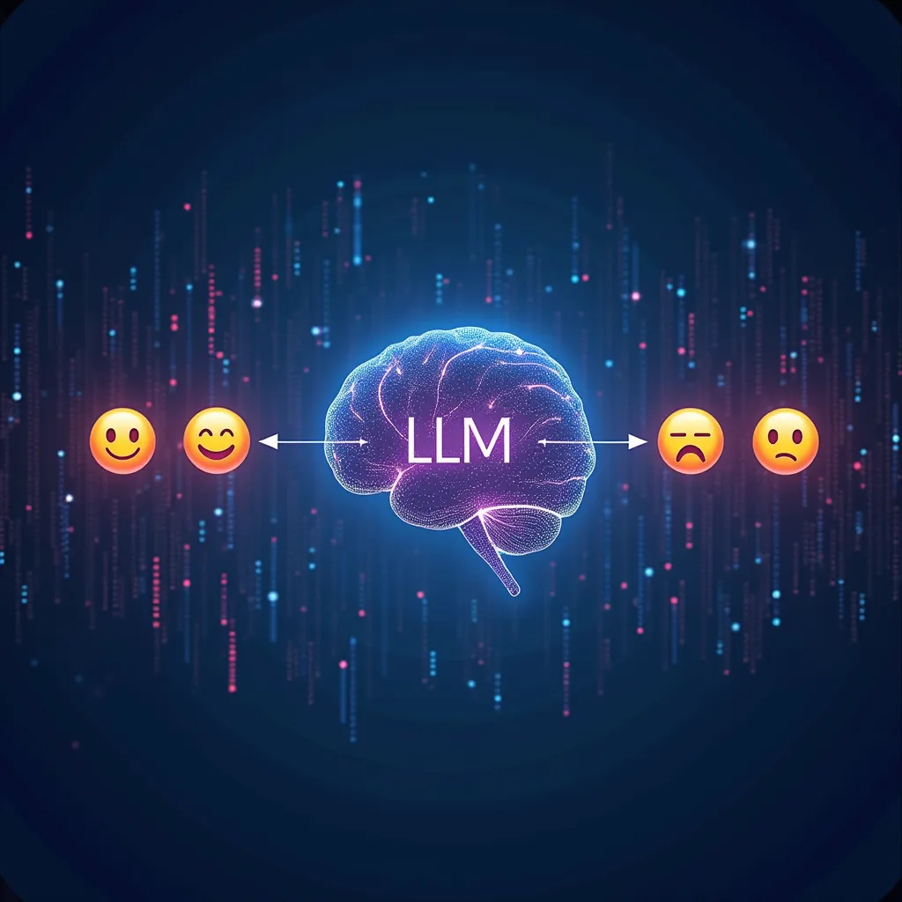
Introduction
Goal: Assess if LLMs offer consistent, efficient, and potentially less biased sentiment annotation.
Comparison: Evaluate feasibility and advantages of integrating LLMs in sentiment analysis.
Impact: Revolutionize sentiment data processing and interpretation across various applications.
Significance for Low-Resource Languages: Highlight challenges and benefits for languages like Serbian, where annotated corpora are scarce, limiting traditional sentiment analysis models.

Slide 3
Dataset
For this research 1089 sentences was extracted with strong polarity from the SrpELTeC corpus, text collection of novels first published in the period of 1850-1920 written on Serbian.
The process of annotating sentences occurred in several phases:
1) extraction of 30K sentences from srpELTeC;
2) manual evaluation by four annotators, where the annotation is conducted on a scale from -5 to -2 for negative sentiment gradation; -1, 0, 1 for neutral (objective) sentiment; and 2 to 5 for positive sentiment and
3) calculating inter-annotator agreement was calculated using ReCal2 tool that showed: Percent Agreement 82.5%, Scott's Pi 0.737, Cohen's Kappa 0.739, Krippendorff's Alpha (nominal) 0.737.

Slide 4
SrpELTeC corpus
To apply distant reading methods, careful selection of texts according to chosen criteria and preparation are required. COST Action CA16204 (2017-2022) "Distant Reading for European Literary History" was focused on this task.
The multilingual comparable corpus ELTeC (European Literary Text Collection), which includes 100 novels first published between 1840 and 1920 was published.
The srpELTeC was created as a subcollection of the ELTeC corpus by JeRTeh (Society for Language Resources and Technologies) https://jerteh.rs/, under supervision of prof. Cvetana Krstev.

Slide 5
SrpELTeC corpus - Github

Slide 6
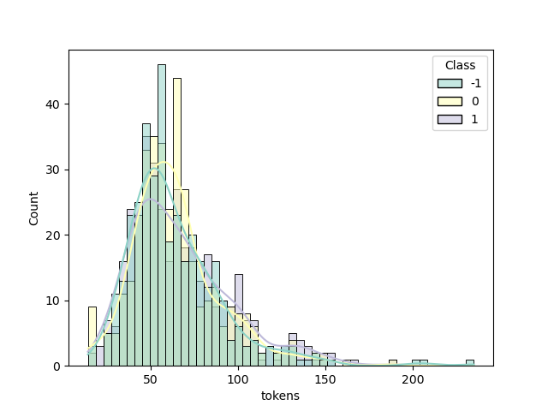
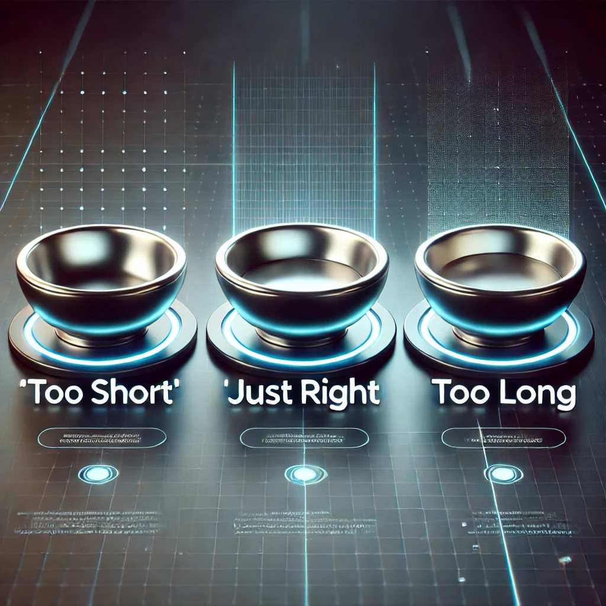
Dataset Sentence length (in words) distibution

Slide 7
Zero and Few-Shot Learning Definitions
Zero-Shot Learning: "Model performs a task without prior examples."
Few-Shot Learning: "Model performs a task with a few example-based prompts."
LLM: "Large Language Models, like Mistral, generalize knowledge across multiple tasks."

Slide 8
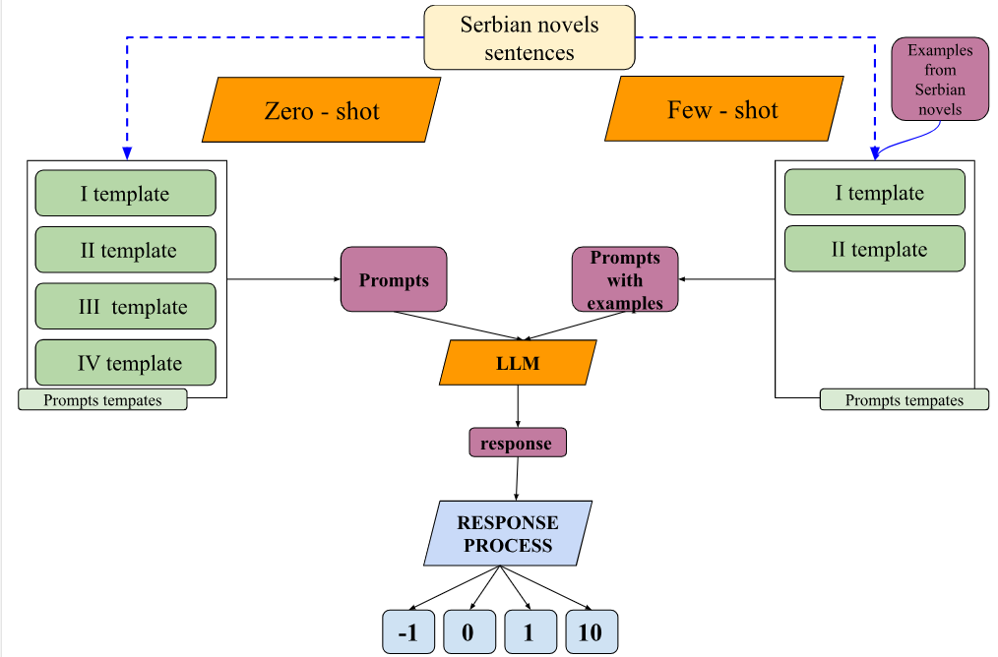
Methodology

Slide 9
Technical Setup for Zero and Few-Shot Learning
Zero shot
Library Used: Hugging Face Transformers.
Model: Mistral 7B-Instruct.
Efficiency: Concise, single-word outputs with no additional examples.
Few shot
Library Used: Llama.cpp with Quantized Models.
Model: Mistral 7B-Instruct (quantized to 8-bit).
Reason: Longer prompts (due to examples)

Slide 10
Prompts templates
Zero shot
simple - role play as expert
chain of though - role play as expert
chain of though - role play as professor of Serbian literature
simple with ALL CAPS - role play as professor of Serbian lit.
Few shot
simple with examples
discontinued

Slide 11
Prompts example - Zero shot 1
Serbian
Kao ekspert za analizu sentimenta, analizirajte sledeći tekst na srpskom jeziku i odredite njegov sentiment. Sentiment treba da bude striktno klasifikovan kao "pozitivan", "negativan", ili "objektivan". Nijedan drugi odgovor neće biti prihvaćen! Tekst: {text} Sentiment:
English
As an expert in sentiment analysis, analyze the following text in Serbian and determine its sentiment. The sentiment should be strictly classified as "positive", "negative", or "objective". No other response will be accepted! Text: {text} Sentiment:

Slide 12
Examples used in Few Shot
Text in Serbian | English Translation | Label
Kukavan mlad čovek; on bejaše tako dobar i veran drug,“ prihvati jedan drugi, kom su oči bile pune suza | A cowardly young man; he was such a good and faithful friend,” another accepted, his eyes full of tears. | -1
Juh, ala je to dobra žena, dobra kao dobar dan! | Wow, what a good woman, as good as a good day! | 1
Nisam valjada ni pet puta udario, a pola avana odlete u stranu, a druga se polovina, koja je bila nešto veća, prevrte i rastok ode u prašinu... | I surely didn't hit it five times, and half of the mortar flew to the side, and the other half, which was slightly larger, turned over and crumbled into dust... | 0

Slide 13
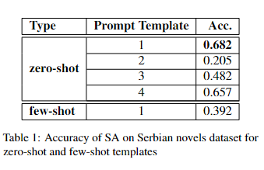
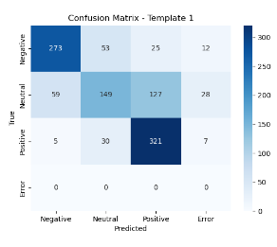
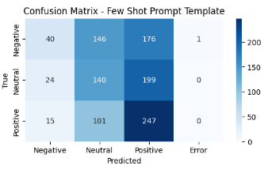
Results
Confusion matrix for zero shot first template
Confusion matrix for few shot template

Slide 14
Examples of Incorrectly Labeled Sentences
Text in Serbian | English Translation | Annotators | Model
U Ivanu žilice se zaigraju, srce mu se stesni; ove dve tri reči, koje Mladen izusti, učine mu se proročanstvo koje ovaj govori iz magnetičnog sna. | In Ivan, his veins begin to throb, his heart tightens; these two or three words uttered by Mladen seem to him a prophecy spoken from a magnetic dream. | -1 | 1
Sto je bio sav mokar, i s njegovih krajeva kapala je voda s mrvicama od duhana i pepelom od cigara, koji sam ja otresao na svećnjak. | Table was completely wet, and water dripped from his edges along with bits of tobacco and cigarette ash, which I shook off onto the candlestick. | 0 | -1
Oh, da znate vi, dragi prijatelju, kakva je to naslada prolivati suze na grudima vernog prijatelja il ’ ljubavnika!... | Oh, if you only knew, dear friend, what a delight it is to shed tears on the chest of a faithful friend or lover!... | 1 | 10

Slide 15
Comparison of Accuracy with Previous Sentiment Analysis Approaches
Previous Methods
MNB with Sentiment Lexicon:
Accuracy: 65.7%
Relies on manually constructed sentiment lexicons.
MNB with Bag-of-Words + Lexicon Features:
Accuracy: 71.9%
Combines bag-of-words model with lexicon-based features for sentiment analysis.
This Study
Mistral 7B-Instruct (Zero-Shot):
Accuracy: 68.2%
No need for manually labeled training corpus.
Simpler setup with fewer resources required.

Slide 16
Conclusion
Zero-Shot Learning Performance:
Achieved superior results with the simplest prompt in literary texts (68.2% accuracy).
Quantized Models:
Appeared to strip away many of the benefits typically associated with the Mistral model.
Highlight:
All-caps prompts were effective in eliminating unusable responses, but reduced accuracy
instructing LLM to detect sarcasm resulted in over detection

Slide 17
Future Work
Run Zero-Shot Prompts on Quantized Mistral:
Investigate whether quantization itself degrades performance for less-studied languages like Serbian
Compare with Fine-Tuned XLM-R Models:
Plan to compare zero-shot learning with fine-tuned XLM-R models to assess whether more specialized models can outperform general LLMs.

Slide 18
A research conducted with the support of the Science Fund of the Republic of Serbia, project number: 7276.
Text Embeddings - Serbian Language Applications –
TESLA
ТЕСЛА
Thank you for your attention!
milica.ikonic.nesic@fil.bg.ac.rs
ranka@rgf.rs
sasa5linkar@gmail.com
https://tesla.rgf.bg.ac.rs/

