Slide 1
Topic Modeling of the SrpELTeC Corpus: A Comparison of NMF, LDA, and BERTopic
Teodora Mihajlov¹, Milica Ikonić Nešić², Ranka Stanković³, Olivera Kitanović³
¹University of Belgrade, Serbia, ²Faculty of Philology, Serbia
³Faculty of Mining and Geology, Serbia

Slide 2
Presentation outline
Research goals
Corpus (ELTeC and SrpELTeC)
Methodology:
Data
Models
Evaluation
Discusson:
Quantitative results
Qualitative results
Conclusion and Further Work

Slide 3
Research Goals
Discover (latent) topics in the SrpELTeC corpus
Look into topic modeling of literary texts in Serbian
Compare statistical and neural methods for topic modeling
Why topic modeling?
Distant reading for digital humanities (for Serbian) is our research area
Proven to be an effective tool for uncovering common themes and the underlying narratives in texts
Downsides - difficulty of evaluation
https://infoteka.bg.ac.rs/ojs/index.php/Infoteka/issue/view/21

Slide 4
ELTeC corpus
ELTeC (European Literary Text Collection), multilingual literary corpus, developed under the umbrella of the “Distant Reading for European Literary History” COST Action CA16204.
The focus of the COST Action CA16204 is to compile the ELTeC corpus containing collections of European novels published between 1840 and 1920 in various languages.
Selection criteria - to make representative sub-collections for corresponding languages:
a) novels of various sizes: short, medium, long;
b) four twenty-year time periods within the examined time span,
c) canonical (well-known) novels as well as those not known to wider audience, forgotten, without reprints,
d) female and male author.

Slide 5
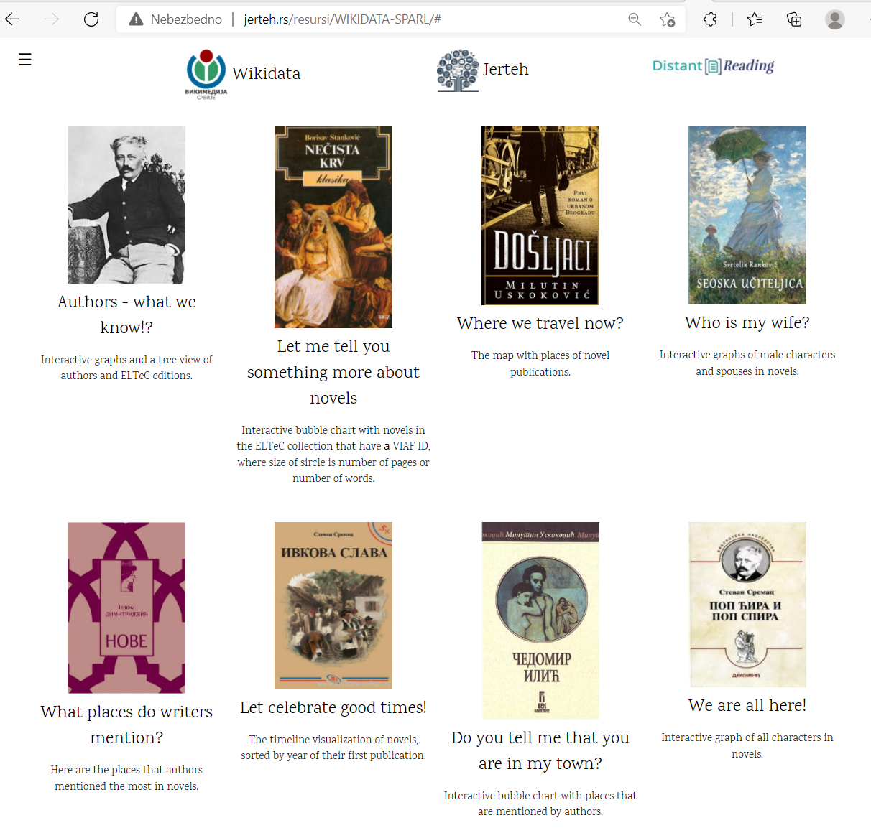
SrpELTeC corpus
The srpELTeC corpus - created as one of the subcollections of the ELTeC, which includes 100 novels in main and additional 20 in extended collection.
71 authors: 66 male with 109 novels and 5 female authors with 12 novels.
120 novels with:
5,263,071 words, 22,700 pages,
2557 chapters, 158,317 paragraphs,
392,909 sentences, 567 poems, 2972 ​​verses, 939 footnotes, 949 cited works, 803 foreign language segments.
srpELTeC corpus is maintained by JeRTeh (Society for Language Resources and Technologies) https://jerteh.rs/ and freely available for academic and commercial use as plain text, TEI with 2 version (levels) annotations, NIF RDF linked data, Wikidata.
https://wd.jerteh.rs/

Slide 6
SrpELTeC https://github.com/COST-ELTeC/ELTeC-srp

Slide 7
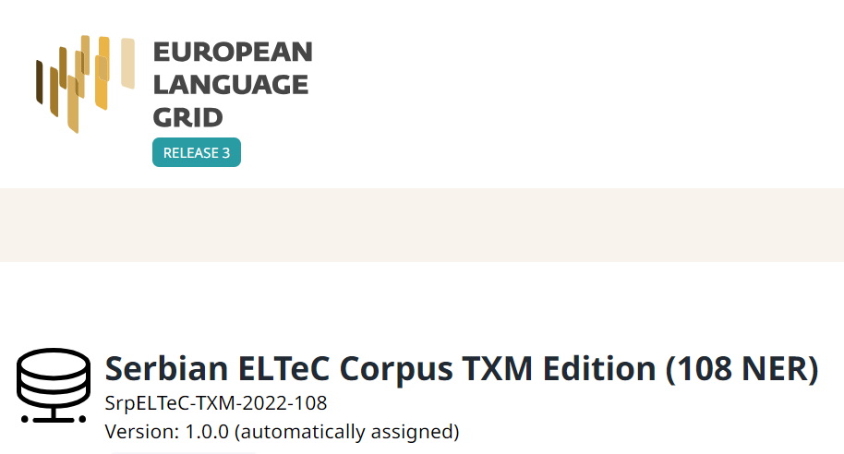
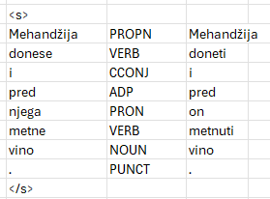
Methodology
Dataset
SrpELTeC TXM Copus of 108 novels in level-2: annotated with POS, lemma, and 7 NER categories: PERS, ORG, LOC, DEMO, WORK, EVENT, and ROLE.
For this research, only nouns (NOUN) were used.
The butler brought and placed the wine in front of him
https://live.european-language-grid.eu/catalogue/corpus/23621
Notes:
https://www.mdpi.com/2227-7390/10/5/838/pdf Preprocessing steps

Slide 8
Methodology
Statistical Topic Modeling Methods
Latent Dirichlet Allocation (LDA) is a generative probabilistic model used for topic modeling, which aims to discover hidden themes within large collections of text data.
Latent refers to the fact that the topics are hidden and must be inferred from the data.
Dirichlet distribution models the allocation of topics within documents and the distribution of words within those topics.
LDA assumes that each document is a mixture of topics, and each topic is a mixture of words. The algorithm works by analyzing word patterns across documents to uncover the latent structure of topics.
Evaluated Topic Coherence (TC) for the number of topics between 2 and 10
Number of topics = 5

Slide 9
Methodology
Statistical Topic Modeling Methods
Nonnegative Matrix Factorization (NMF) is a dimensionality reduction and topic modeling technique for analyzing large datasets, including text data.
Nonnegative means that only positive values are used in the matrices, which is useful for textual data where word frequencies cannot be negative.
Matrix Factorization refers to decomposing a large matrix (e.g., a document-word matrix) into two smaller matrices.
NMF breaks down the original matrix into components, making it easier to identify latent topics or patterns within the data by uncovering hidden structures. Each document is represented as a combination of topics, and each topic is a combination of words.
Evaluated Topic Coherence (TC) for the number of topics between 2 and 10
Number of topics = 7

Slide 10
Methodology
Deep Learning Topic Modeling Methods
BERTopic
Getting word embeddings:
distiluse-base-multilingual-cased-v2: 512 dimensions, 135 million parameters, fine-tuned for clustering and semantic search
paraphrase-multilingual-MiniLM-L12-v2: 384 dimensions, 117 million parameters
paraphrase-multilingual-mpnet-base-v2: 768 dimensions, 278 million parameters
Jerteh-355: monolingual, Serbian, 55 million parameters, not fine-tuned for semantic search
Dimensionality reduction: UMAP
Clustering: HBDSCAN min. cluster size = 3
Creating topic representations: CountVectorizer + class-based c-TF-IDF

Slide 11
Evaluation metrics
Quantitative:
Topic Coherence (TC) - measure of semantic relatedness between the words for each topic, ranges from 0 to 1, where:
1 = more related topic words
0 = less related topic words
It measures how semantically consistent the words within a topic are.
Topic Diversity (TD) - % of unique words for top_n words for each topic, ranges from 0 to 1, where:
1 = more related
0 = redundant topics
It measures the proportion of unique words across all topics.

Slide 12
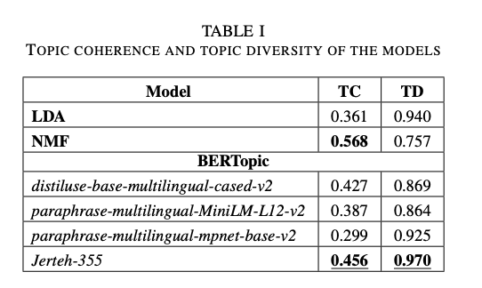
Results

Slide 13
Results
Best Topic Coherency (TC): NMF
Best Topic Diversity: BERTopic
Possible reasons for relatively poor performance:
information loss during the dimensionality reduction step
Possible solution:
document chunking
omit the dimensionality reduction step - problem: long training

Slide 14
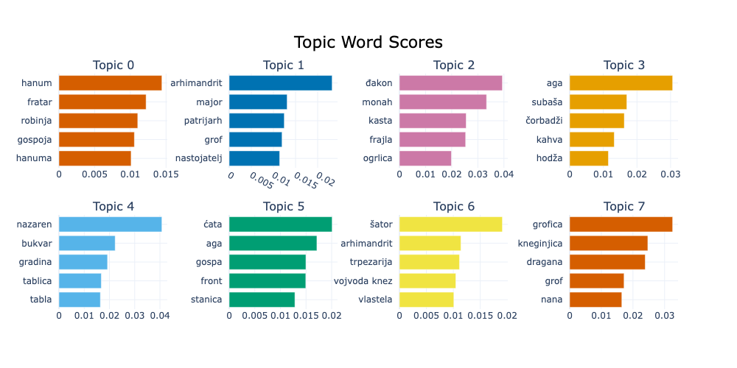
Results

Slide 15
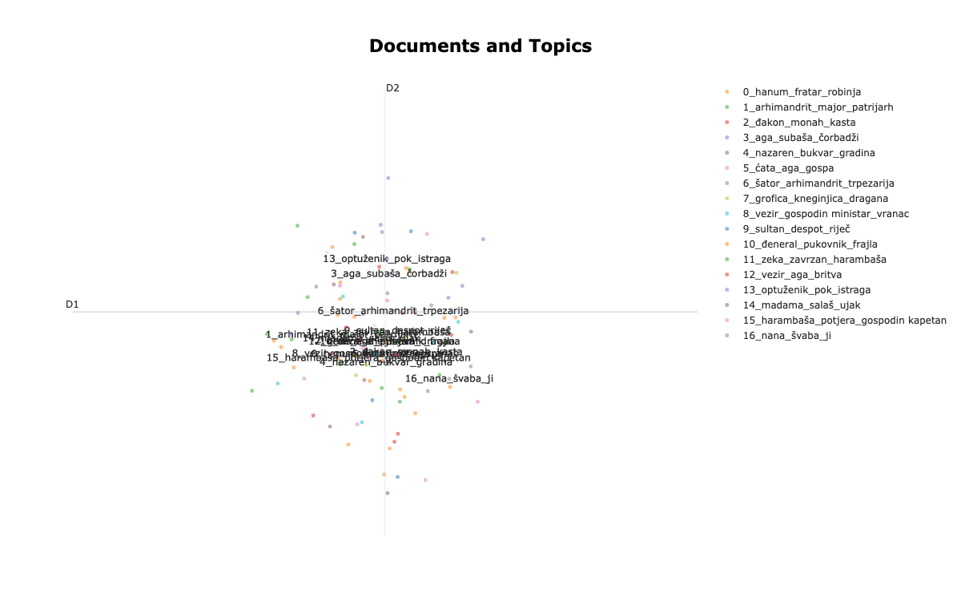
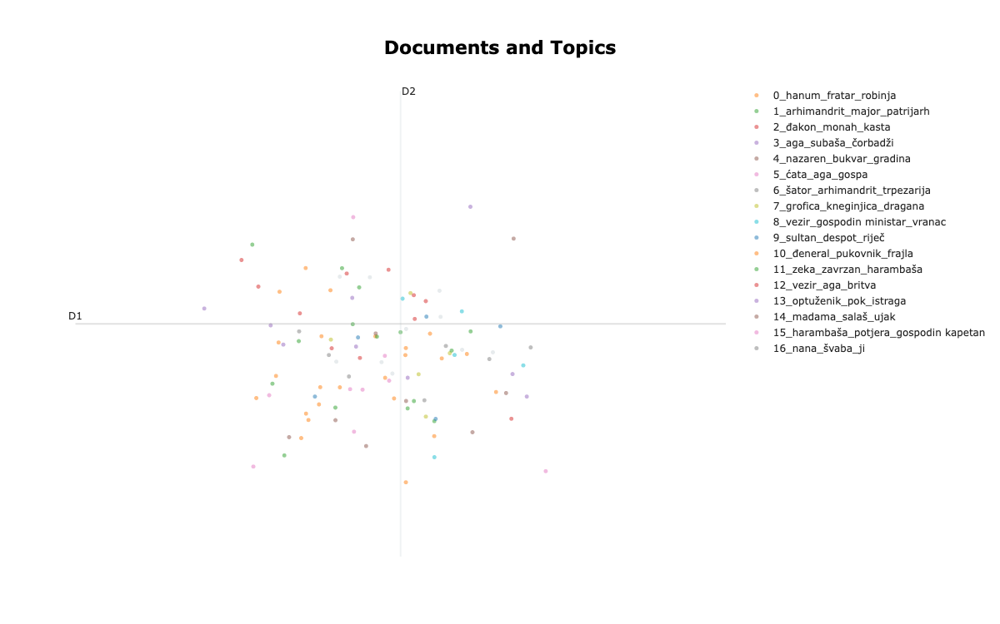
Results
With labels
Without labels

Slide 16
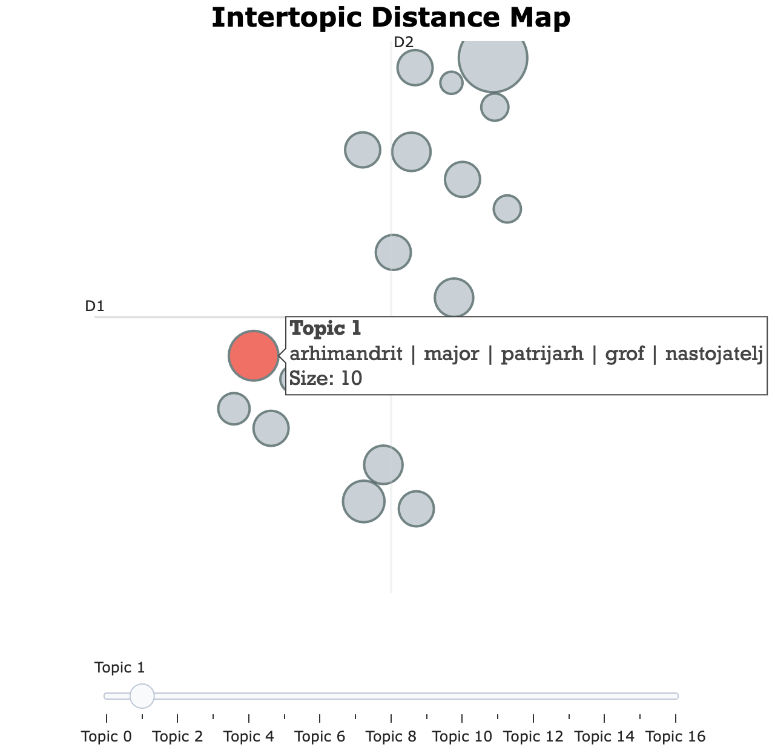
Results
The topics are not overlapping, but clusters exist
The distribution of documents across topics is uneven

Slide 17
Conclusions and Further Work
BERTopic
outperformed the traditional models only at TD,
fell short for TC
Addressing the limitations of current work:
Explore the effects of using chunked texts
Try other embedding models for Serbian (e.g., BERTić) with BERTopi
Topic modeling results (final)
Assign to novels metadata
Add to Wikidata
Make web page with visualisation
Topics per novels
Novels per topics

Slide 18
Questions?
A research conducted with the support of the Science Fund of the Republic of Serbia, project number: 7276. Text Embeddings - Serbian Language Applications – TESLA
Thank you for your attention!
Should you want to discuss our work, feel free to reach out:
teodoramihajlov@gmail.com milica.ikonic.nesic@fil.bg.ac.rs
ranka.stanovic@rgf.rs.bg.ac.rs olivera.kitanovic@rgf.rs

