Slide 1
SrpCNNeL: Serbian Model for Named Entity
Linking
Milica Ikonić Nešić¹, Saša Petalinkar², Ranka Stanković³, Miloš Utvić¹, Olivera Kitanović³
Serbia, University of Belgrade: ¹Faculty of Philology, ²Multidisciplinary Studies, ³Faculty of Mining and Geology, Serbia

Slide 2
Outline of presentation
Data preparation
SrpCNNEL model
text annotation
knowledge base development
training
Evaluation
Applications

Slide 3
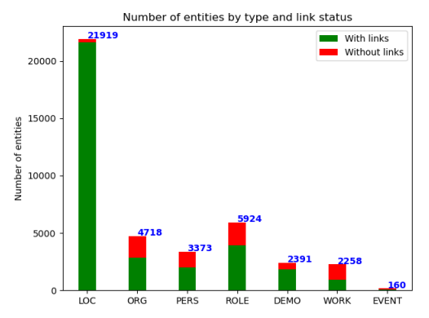
Dataset overview
Data Diversity:
The dataset includes data from various domains, such as literary texts, legal documents, and automatically generated sentences from the Wikidata knowledge base and Leximirka (https://leximirka.jerteh.rs/).
This diversity ensures the model can handle a wide range of writing styles and sentence structures, allowing for better generalization across different contexts.
Entity Categories:
The dataset covers seven main entity types:
persons (PERS), locations (LOC), organizations (ORG),
professions (ROLE), works of art (WORK),
demonyms (DEMO), and events (EVENT).
Entity Distribution:
Locations make up the majority of entities in the dataset,
as they are the primary focus of this research.

Slide 4
Chalange:
Serbian language has the rich inflectional morphology.
Handling of Inflections:
The dataset includes inflected forms of entities, which is critical for Serbian due to its complex morphological structure. This helps the model link entities in various grammatical cases to their canonical forms in the knowledge base.
Synthetic Data:
Synthetic sentences were generated to cover all grammatical cases and ensure better entity recognition, for locations, organizations, and persons.

Slide 5
DATA PREPARATION
Synthetic dataset with inflected forms to ensure that all inflected forms of the mentioned entity in the text are linked with the same item in the KB. For instance, Beograda, Beogradu, or Beogradom are linked to the item Beograd (Q3711).
https://leximirka.jerteh.rs/
16896 sentences

Slide 6
Manually annotated dataset: 22,730 sentences from novels and legal documents:
Jules Verne’s “Around the World in Eighty Days”,
Orwell’s “1984”
The novels from the It-Sr-NER corpus (Umberto Eco’s “The Name of the Rose”, Carlo Collodi’s “The Adventures of Pinocchio”, Elena Ferrante’s “Those Who Leave and Those Who Stay”, and Luigi Pirandello’s “One, None and a Hundred Thousand”)
Ivo Andrić’s “Anikina vremena” (“Legends of Anika”) ,“Na drini ćuprija” (“The Bridge on the Drina”),
Borisav Stanković’s “Nečista krv” (“Impure Blood”),
The legal documents from Intera available on the Biblisha digital library.

Slide 7
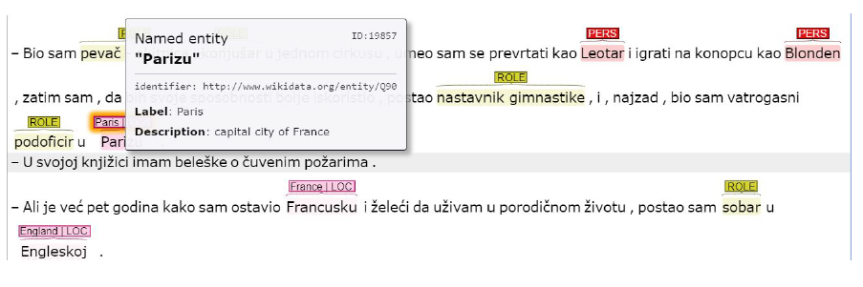
Manual Correction after automatic annotatiion:
Automatic annotation of named entities: Jerteh-355-tesla model
Manual correction on INCEpTION platform to correct any misclassified entities or errors in linking to the Wikidata knowledge base, allowing for a higher level of precision in the final dataset.
This manual step was particularly important for handling complex cases such as ambiguous entities, homonyms (e.g., "Sava" as a river or a person's name), and ensuring that all entity instances were linked to the correct knowledge base entries.

Slide 8
Based on SrpCNNER2 model and spaCy pipeline
Includes transformer layer with jerteh 355 tesla BERT model
Jerteh-355 Tesla BERT is based on the BERT (Bidirectional Encoder Representations from Transformers) architecture, which is designed to capture contextual information from both directions in a sentence.
The model was fine-tuned specifically for Serbian NER (Named Entity Recognition) tasks, leveraging the RoBERTa-large architecture as its foundation.
BERT’s ability to consider context in both directions (left and right of the target word) makes it highly effective for tasks that require understanding word meaning in context, which is crucial for languages like Serbian with rich inflection and complex syntax.
Custom alignment algorithm for BERT tokens
MODEL ARCHITECTURE

Slide 9
The SrpCNNER2 model is Named Entity Recognition (NER) system trained for Serbian.
1. Model Architecture:
SrpCNNER2 is based on the Convolutional Neural Network (CNN) architecture, which is widely used for tasks that require pattern recognition and feature extraction in text data.
Proven effective for certain NLP tasks, including NER, due to their ability to capture local dependencies in the data (such as patterns within a word or phrase).
2. Entity Categories Recognized:
SrpCNNER2 is trained to recognize seven categories: PERS, LOC, ORG, ROLE, DEMO, WORK and EVENT
The wide coverage of entity types enables SrpCNNER2 to function across diverse domains, including literary works, legal documents, and news articles.

Slide 10
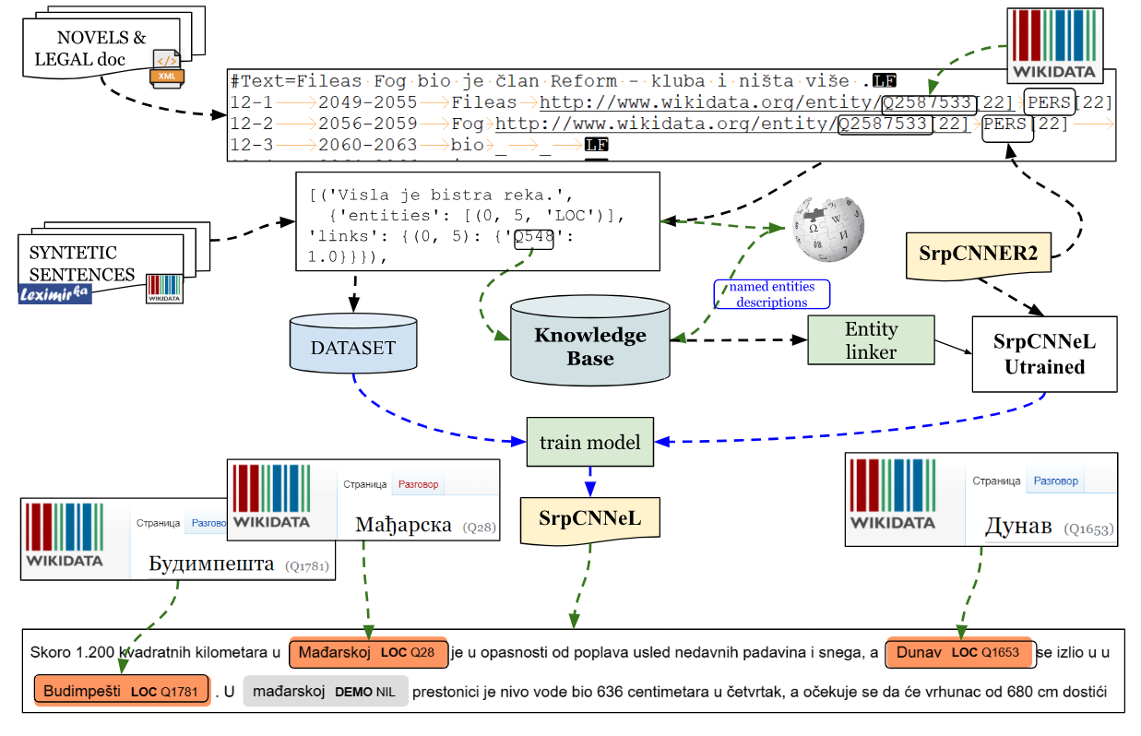
SrpCNNeL model

Slide 11
Knowledge base development
Extracts QUID and all aliases (that appear in the dataset) linked to it
Loads definition from Wikipedia (in Serbian)
Vectorises definition using SPRCNNER2
Creates object that connect QUID and definition
For each alias assings all QUID to which is linked in text
Entity linker layer
SRPCNNNER2 extract all recognised NE, that are candidates for linking
If candidate is equal to one aliases, all possible QUIDs (and NIL) are assigned to it
Candiate is vectorised by SRPCNNNER2
Model trained on that layer compares vectors for QUIDS and candidate, and select one
Selected QUID is linked to candidate

Slide 12
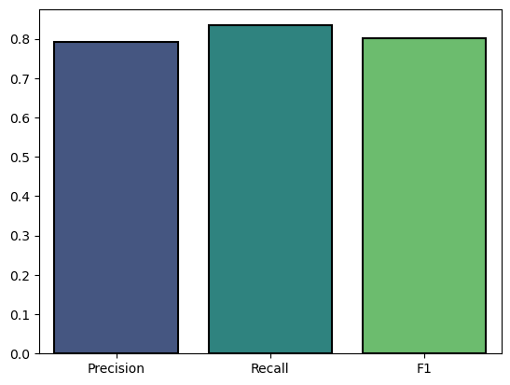
Evaluation on test dataset
Precision: 0.79
This indicates how many of the entities that were linked by the model were correctly linked to the knowledge base (Wikidata).
Recall: 0.83
Measures how well the model can recognize all relevant entities in the dataset.
F1 Score: 0.80
The harmonic mean of precision and recall, providing an overall measure of model accuracy
Evaluation on the test dataset
Evaluation on the separate dataset

Slide 13
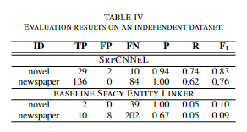
Novel Dataset (The Good Soldier Švejk):
The spaCy (generic) F1 score only 0.10 compared to SrpCNNeL’s 0.83.
Newspaper Dataset (Politika articles):
spaCy F1 score was 0.09, whereas SrpCNNeL achieved 0.76.
SrpCNNeL significantly outperforms the SpaCy as a baseline model, especially in recognizing and linking location entities in Serbian.
The model still struggles with linking less frequent entities, suggesting that there is still room for improvement.
Comparison with spaCy Entity Linker
Given that locations constituted the majority of the named entities that were linked, the evaluation of this model's performance for comparison was focused on locations.

Slide 14
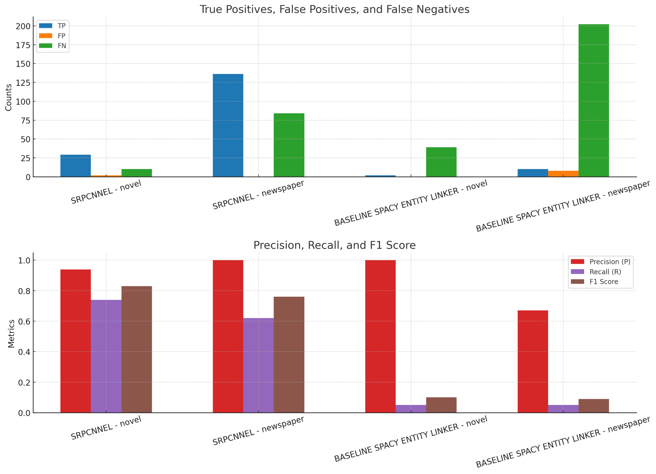

Slide 15
The SrpCNNeL model represents the first attempt at training a NEL system specifically for Serbian
The model demonstrated F1 score of 0.80 on the test set.
The synthetic dataset approach, which handled inflected forms of named entities, was essential for achieving high accuracy, given the unique linguistic structure of Serbian.
Despite satisfactory results, the model still struggles with non-linked entities and more complex cases, particularly due to the limited size of the training dataset.
Conclusion

Slide 16
Expand the training dataset: larger and more diverse dataset to improve the model’s performance, especially for less common entities.
Incorporate transformer models: Future iterations of the SrpCNNeL model could benefit from advanced language models like BERT or other transformer-based architectures, which have shown superior performance over CNNs in named entity recognition tasks.
Enhance entity linking for rare entities: More research will be directed toward improving the recognition and linking of infrequent entities, potentially by enriching the Wikidata knowledge base and expanding entity properties.
Domain-specific improvements: The model could be further refined for specific domains such as legal texts, historical documents, or biomedical data by incorporating domain-specific knowledge and datasets.
Future work

Slide 17
pip install https://huggingface.co/Tanor/sr_SRPCNNEL/resolve/main/sr_SRPCNNEL-any-py3-none-any.whl
SRPCNNEL
2

Slide 18
Thank you for your attention!
A research conducted with the support of the Science Fund of the Republic of Serbia, project number: 7276.
Text Embeddings - Serbian Language Applications –
TESLA
ТЕСЛА
milica.ikonic.nesic@fil.bg.ac.rs
ranka@rgf.rs
https://tesla.rgf.bg.ac.rs/

